Slide 1

Introduction to DBMS and SQL

Slide 2


Course: Data Analysis Toolkit
Lecture On: Introduction to Database Management Systems and MySQL
Instructor:

Slide 3
SOME GUIDELINES
Prerequisites - Learners are expected to have all the prerequisites required for this session
Focus - Learners are expected to concentrate during the session
Tools - Learners are expected to keep ready and use pen and paper, calculator
Chat - Civil and disciplined chat is encouraged
Quizzes - Learners are expected to solve all quizzes in real-time and share their answers
Break - Learners might get a 5-10 minute break during mid-time depending on the nature of the session
Polls - Learners are requested to give feedback using the mid-poll and end-poll
Reading - Learners are expected to do additional reading as instructed by the lecturers

Slide 4
Agenda
Data and database management
Relational and non-relational DB
Data warehousing and ETL
Dimensional modelling
Keys and constraints
MySQL workbench

Slide 5
Part - 1
Data and database management

Slide 6
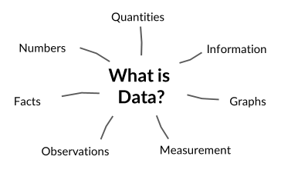
WHAT IS DATA?
Information formatted in a specific manner
To be useful, data should be:
Accurate
Consistent
Complete
Relevant
Data can be stored in two forms:
Structured
Unstructured
Notes:
Accuracy
Critical for making informed decisions.
Validating that medical records correctly list a patient’s allergies to prevent harmful drug interactions.
Consistency
Prevents conflicts and errors in data analysis.
Ensuring that sales data across different systems (e.g., CRM and accounting) consistently match, avoiding discrepancies.
Completeness
Essential for comprehensive analysis and insights.
Collecting complete demographic information (age, gender, income) for accurate market segmentation.
Relevance
Increases efficiency by focusing on useful information.
Identifying relevant social media content for a brand’s marketing strategy.

Slide 7
DATA MANAGEMENT
Data Storage Methods: File storage, Block storage (Hard disks), Object storage
Why do we need to manage data?
Properly managed data provides valuable insights. Data is everywhere.
How can we store and manage this data?
Use Databases.
What is a Database?
A collection of data that can store, manage and retrieve large amounts of structured and unstructured data.
Notes:
Hook - After knowing that data is everywhere you must be wondering that where and how this huge amount of data gets stored? Also, how is this used by data scientists in analysis.
To make management of data easy, we use databases.

Slide 8
TRADITIONAL DATA MANAGEMENT SYSTEMS
We have traditional storage like file systems or Excel sheets, then what is the need of databases?
Problems with file systems:
Data searching: Each search requires separate program
Redundancy: Multiple files containing same data
Complexity in update: Data needs to be updated in each file
Data integrity: Lacks procedure to ensure constraints
Data sharing: Sharing data is complex, and multiple users can not access
What about using MS Excel or Python for EDA?
These allow direct calculations on the data using formulas.
These are more flexible than file systems.
Spreadsheets:
Have cell limits, restriction on amount of data
Python:
Everything is stored in files, requires a large amount of storage
Notes:
Discuss a bit about constraints here - it has been explained in detail later

Slide 9
DATABASE MANAGEMENT SYSTEMS
Integrity
01
A set of computer programs that manage databases
Perform operations on our data in an organized manner
Create, store, retrieve, and modify data
Security mechanisms: Control access to the data, ensure data consistency and accuracy
More intricate than file systems
Consistent/Centralized
05
Advantages of
DBMS
02
Scalable
Multi-user access
04
03
Efficient searching

Slide 10
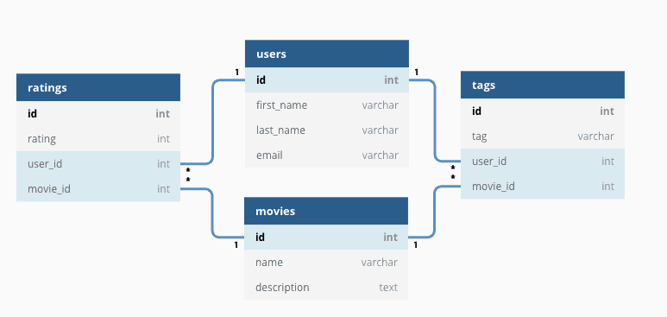
RELATIONAL DBMS
The Science of Data Mining - Data Collection (linkedin.com)
Notes:
An RDBMS is a type of DBMS that stores data in a relational database, or different tables with clearly defined relationships.
It enforces relationships, constraints, and rules for data integrity, and reduces data redundancy
Supports multiple users concurrently.
From here on, the DBMS we refer to will typically mean RDBMS.

Slide 11
DATA TYPES IN SQL
Examples
Numeric
asd
Int, float
12, 7, 4.3. 0.4
Character String
Char, varchar
“Hello World!”
Unicode Character String
nchar, ntext
N'Alice'
SQL Data Types
Binary
binary, image
0, 1
Date and Time
Date, datetime
'2024-06-10 14:00:00'
Miscellaneous
Xml, json
<Name>John Doe</Name>
NULL
Missing value

Slide 12
PRIMARY KEY
CustomerID | First Name | Last Name | Age
1 | John | Wick | 37
2 | Sheldon | Cooper | 42
3 | Charlie | Harper | 47
COMPOSITE KEY
FOREIGN KEY
OrderID | ProductID | Product Quantity | CustomerID
1 | 1221 | 1 | 2
2 | 1334 | 1 | 2
3 | 1445 | 2 | 3
4 | 1117 | 1 | 1
Notes:
Primary key : This is a unique identifier for each row in a table, it helps prevent duplicates.
Foreign key: It is a reference to the primary key of another table, this helps us retrieve data from tables.
Composite key: When two or more columns together are used to identify a row in a table, these columns are called composite keys.

Slide 13
A.C.I.D. PROPERTIES
A transaction represents a sequence of actions (such as reading, writing, or modifying data) that must be executed together as a single unit. Transactions ensure data consistency and integrity within a database.
ATOMICITY
CONSISTENCY
Ensures that either an entire transaction happens at once or it does not happen at all.
Ensures that a database remains consistent before and after a transaction.
ISOLATION
DURABILITY
Ensures that multiple transactions can be carried without interruption.
Ensures that the changes of a successful transaction should occur even if the system fails.

Slide 14
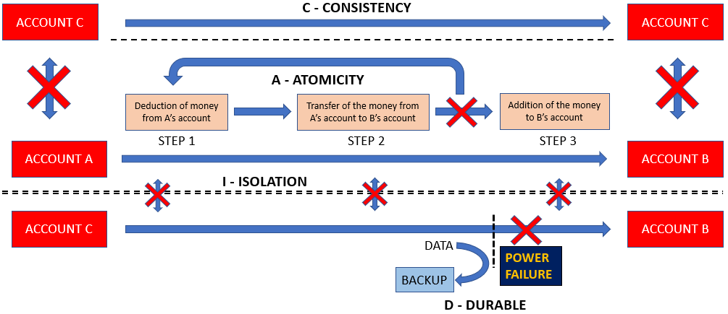

Slide 15
Relational Databases
23
Advantages | Disadvantages
1. Easy to structure data | 1. Rigid, restricts ﬂexibility
2. Efﬁcient querying as optimisations, such as indexing are possible | 2. Not horizontally scalable
3. Easy to navigate and explore data | 3. Minimal/No support on semi-structured data, such as JSON objects and XML data types
4. Easy to deﬁne relationships between data points | NA

Slide 16
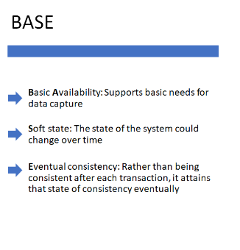
Non - Relational Databases
Non Relational databases offer more flexibility than relational databases
They are better at handling large scale, high volume
data
Non Relational databases follow the BASE model

Slide 17
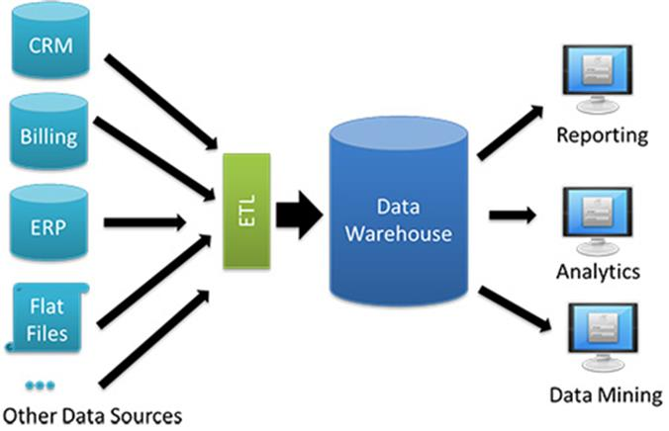
DATA WAREHOUSE
A central repository of integrated data from one or more sources. Need for a single version of the truth and the facts.
But how does it differ from a database?
https://jonascleveland.com/wp-content
Database | Data Warehouse
Real-time transactions like CRUD (Create, Read, Update, and Delete) | Designed for analysis and reports
Not ideal for large scale analysis | Less frequent updates, as it works with aggregated data
Avoid redundancy to maintain consistency | Avoiding redundancies is not critical
Notes:
Data Warehouses:
Designed for analysis, query processing and reporting.
Structured using dimensional models.
Less frequent updates, as analysts work with aggregated data.
Avoiding redundancy is not critical.
Provide insights from large volumes of data.
Databases:
Designed for real-time transactions (e.g., CRUD operations).
Use normalized schemas for efficient data writing.
Avoid redundancy to maintain data consistency.
Not ideal for large-scale analysis.

Slide 18
You can think of data warehousing as a massive storage hub where every bit of an organization’s data can be organized and stored for future analysis and reporting purposes.
WAREHOUSE
DATA WAREHOUSE
Used by retail companies to store all its goods.
Used by organization to store all its data in databases
Goods are stored such that they can be easily managed or retrieved
Data is stored such that it can be easily managed or retrieved

Slide 19
CHARACTERISTICS OF DATA WAREHOUSE
Subject-Oriented
Integrated
Should contain information about well-defined subjects rather than the enterprise
Contains information from different systems within an organisation
Non-Volatile
Time Variant
Data values in a database cannot be changed without a valid reason
Contains historical data for analysis

Slide 20
SETL/ETL
SETL: Select, Extract, Transform and Load
Select: Identifying the data you want to analyse
Extract: Connecting to the particular data source and pulling out the data
Transform: Modifying the extracted data to standardise it
Load: Pushing the data into the data warehouse
ETL vs ELT
Notes:
ETL is subset of SETL.
When doing on entire data, ETL, when on selective data, SETL
ETL
Data is transformed and then loaded , this is the best method for smaller datasets
ELT Loads data first and then transforms it within the warehouse. This method is best for larger data sets
DATA MIGRATION
Example: taking data from SQL to do some operations and load into Python dataset or some other database
OR
Data from company A -> operations like cleaning, hashing, abstracting -> loading to company B
The data is usually encrypted to preserve privacy.
This is usually done by data engineers, not data scientists.

Slide 21
DIMENSIONAL MODELLING
Dimensional modelling is a technique for faster data retrieval.
This technique is used in defining the structure of data warehouse.
It helps to organize and structure data to make it easy to understand and analyse.
The two main components of a dimensional model are:
FACTS
Measurable data elements that represent the business metrics of interest
For example, a sales data may include facts like revenue, units sold, profits etc.
DIMENSIONS
Descriptive data elements that are used to classify the data
For example, in sales data, dimensions may include product, customer, time, location etc.
Further, the product dimension can have attributes like name and category.
Notes:
FACTS
Measurable data elements that represent the business metrics of interest
Each fact is associated with one or more dimensions, creating a relationship between the fact and its description.
For example, a sales data may include facts like revenue, units sold, profits etc.
DIMENSIONS
Descriptive data elements that are used to classify the data
Each dimension is made up of a set of attributes that describe the dimension.
For example, in sales data, dimensions may include product, customer, time, location etc.
Further, the product dimension can have attributes like name and category.
Additional Reference - GeeksforGeeks

Slide 22
OLTP AND OLAP
Online Transaction Processing
Online Analytical Processing
Operational/Current/Live data
Historical/industrial data
Used to drive the functionality of a live app
Used to drive new features in a web application
Continuous read and write
Fast processing
Done in the form of batch process
Slow processing
Regular backup is necessary
Backup at intervals
Business Process
Data Warehouse
Notes:
Example: In your call logs, the recent calls you can see are the transaction data. And other information like call history, durations, calls per day or month etc are analytical data. For analytics, data has to be aggregated in batches. This aggregation can happen over a period of time.
Data gets recorded at OLTP level, but analysed at OLAP level.

Slide 23
Constraints
Entity Constraints - ensures that each table has a unique primary key, preventing duplicate rows
Referential Constraints - maintains consistency between related tables by ensuring foreign keys correctly reference primary keys in other tables
Semantic Constraints - enforces rules and constraints that ensure data accuracy and logical consistency based on the meaning of the data
Notes:
More details on the next few slides

Slide 24
Entity Constraints
15
This ensures data integrity, which is nothing but the accuracy and consistency of the data stored in the database.
Entity constraints are of the following different types:
Unique: Used for columns that need unique values. Eg: Employee IDs
Null: Determines the columns that can have null values.
Eg: An employee may not need to specify their location and therefore the location column can have a null value.
Primary Key: Determines the column that uniquely identiﬁes a table.

Slide 25
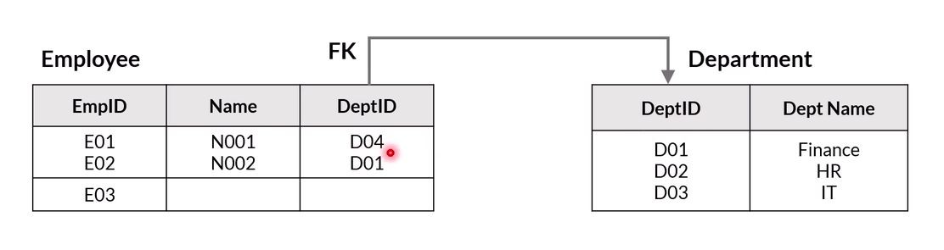
Referential Constraints
16
According to this rule, the value that appears as a foreign key in a table is valid only if it also appears as a primary key in the table to which it refers.
A given table has only one primary key but it can have multiple foreign keys. Before you assign a column as a foreign key, you need to ensure that the primary key column of the table that it refers to is present and it does not have null or duplicate values.
Eg:

Slide 26
Semantic Constraints
17
Semantic constraints impose additional restrictions on the values in a column. Using a semantic constraint ensures that we do not get incorrect data for any row in the database.
Eg: A row with an Indian phone number not having 10 digits after the country code would not be allowed to enter the database.

Slide 27
Part - 2
SQL and MySQL Workbench

Slide 28
Structured Query Language (SQL)
SQL is a computer language used for storing, manipulating, and retrieving data from relational databases.
It serves as the standard language for relational database systems like MySQL, Oracle, and PostgreSQL.
SQL statements are written in a declarative style (focus on “what to do” rather than “how to do it”).
The database management system optimizes query execution (or “how to do”).
Advantages of SQL:
High-level language: Simplifies data manipulation compared to procedural languages.
Efficient query execution: Database system determines the best way to execute queries.

Slide 29
Thank you!

